Slide 1
Sampling From Masked Diffusion Models
September 2025

Slide 2

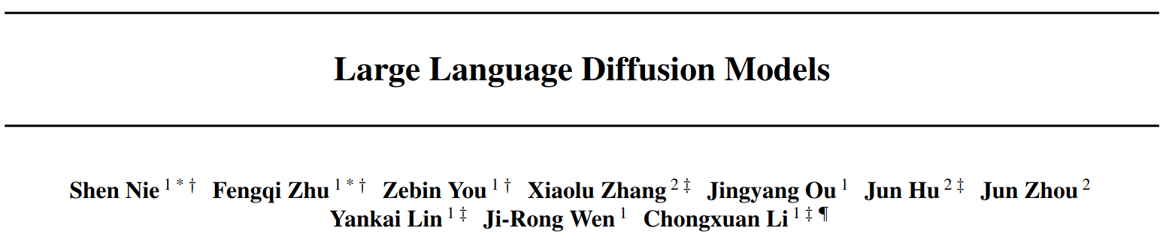
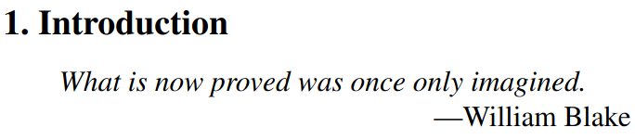
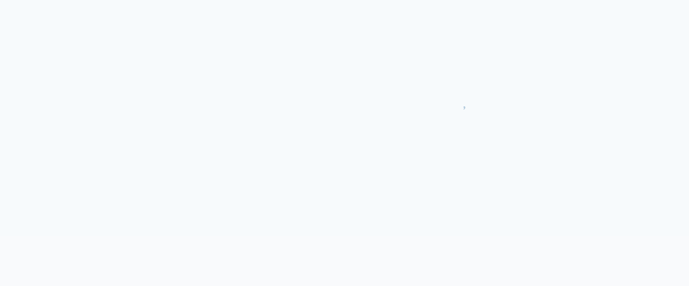
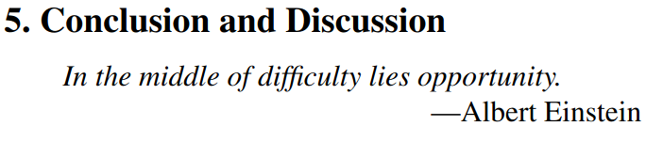
February 2025
“A nice direction to go in, we’ll see if it becomes useful (I’m not convinced)”
“Unlikely that many people other than these authors (who clearly have tons of compute) will be willing to keep scaling these up”

Slide 3
February 2025
“A nice direction to go in, we’ll see if it becomes useful (I’m not convinced)”
“Unlikely that many people other than these authors (who clearly have tons of compute) will be willing to keep scaling these up”

Slide 4
February 2025
“A nice direction to go in, we’ll see if it becomes useful (I’m not convinced)”
“Unlikely that many people other than these authors (who clearly have tons of compute) will be willing to keep scaling these up”

Slide 5
February 2025
“A nice direction to go in, we’ll see if it becomes useful (I’m not convinced)”
“Unlikely that many people other than these authors (who clearly have tons of compute) will be willing to keep scaling these up”

Slide 6
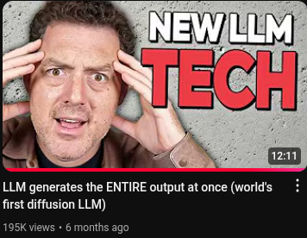
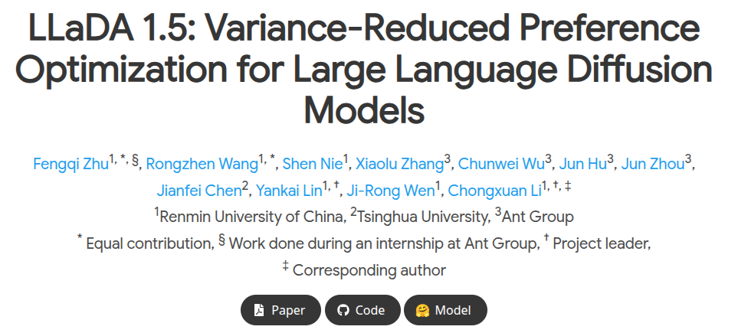
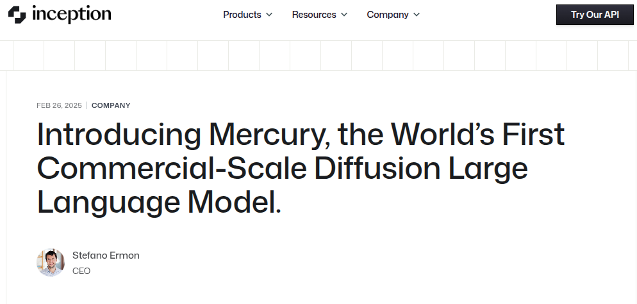
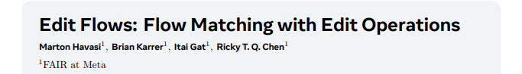
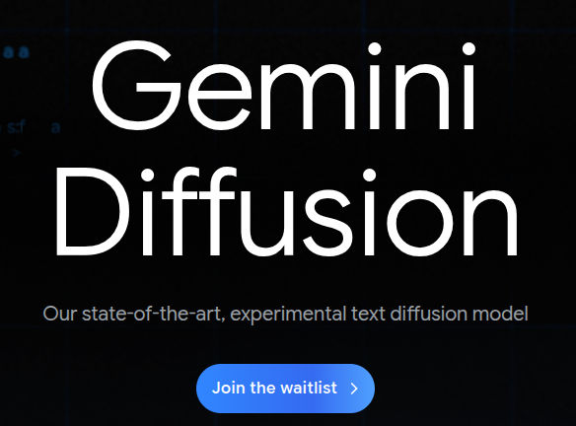
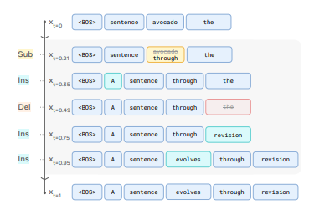
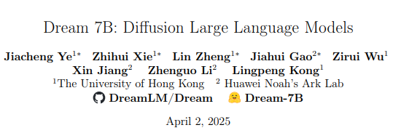
Now

Slide 7
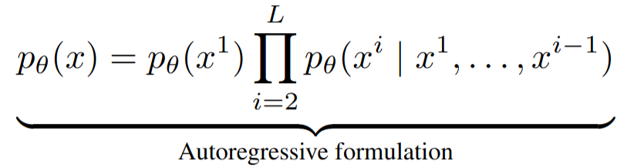
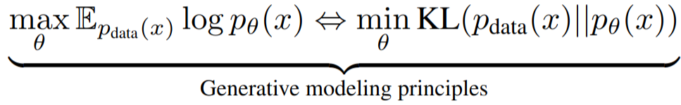
Recap
Autoregressive models (ARMs) are the current standard for LLMS
But other paradigms, e.g. diffusion, should (theoretically) be able to work just as well at generative modelling:

Slide 8
Recap
Autoregressive models (ARMs) are the current standard for LLMS
But other paradigms, e.g. diffusion, should (theoretically) be able to work just as well at generative modelling:

Slide 9
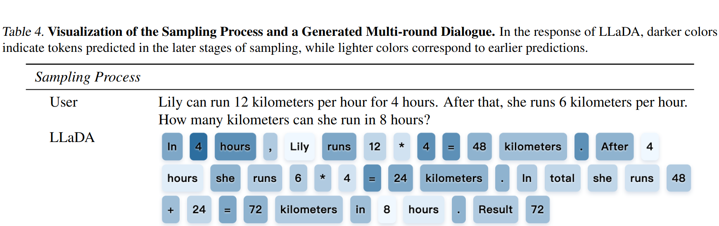
It’s kind of weird…

Slide 10
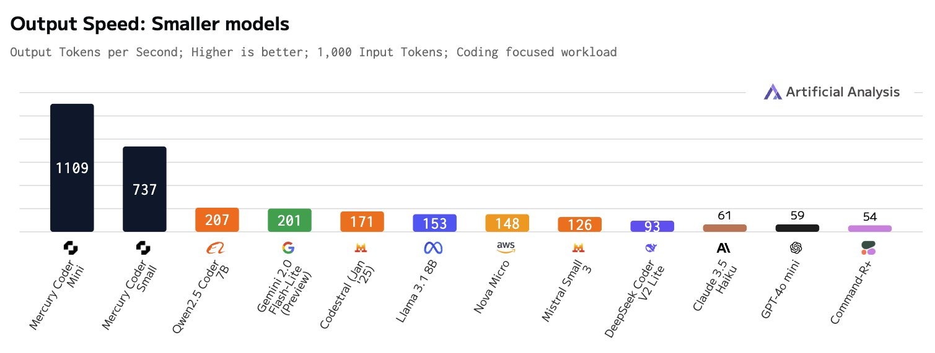
But very fast!
(You can sample multiple tokens in one denoising step)

Slide 11
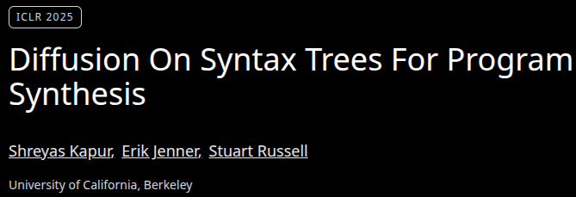
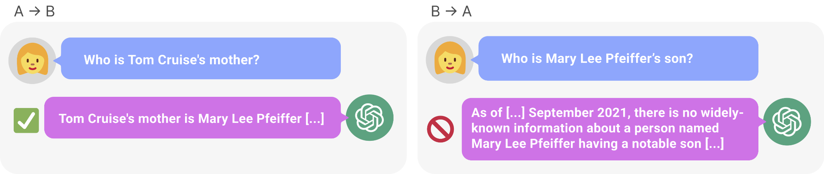
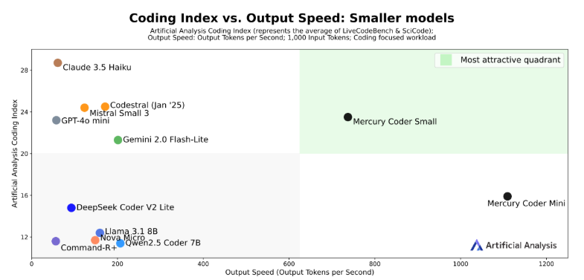
Autoregressive strategies aren’t always ideal
Reversal curse
Global-context in-filling tasks e.g. Sudoku
Coding…?
…although, a properly scaled ARM can probably do most of these things correctly – part of the pull here is doing them well with way fewer params

Slide 12
Autoregressive strategies aren’t always ideal
Reversal curse
Global-context in-filling tasks e.g. Sudoku
Coding…?
…although, a properly scaled ARM can probably do most of these things correctly – part of the pull here is doing them well with way fewer params

Slide 13
Autoregressive strategies aren’t always ideal
Reversal curse
Global-context in-filling tasks e.g. Sudoku
Coding…?
…although, a properly scaled ARM can probably do most of these things correctly – part of the pull here is doing them well with way fewer params

Slide 14
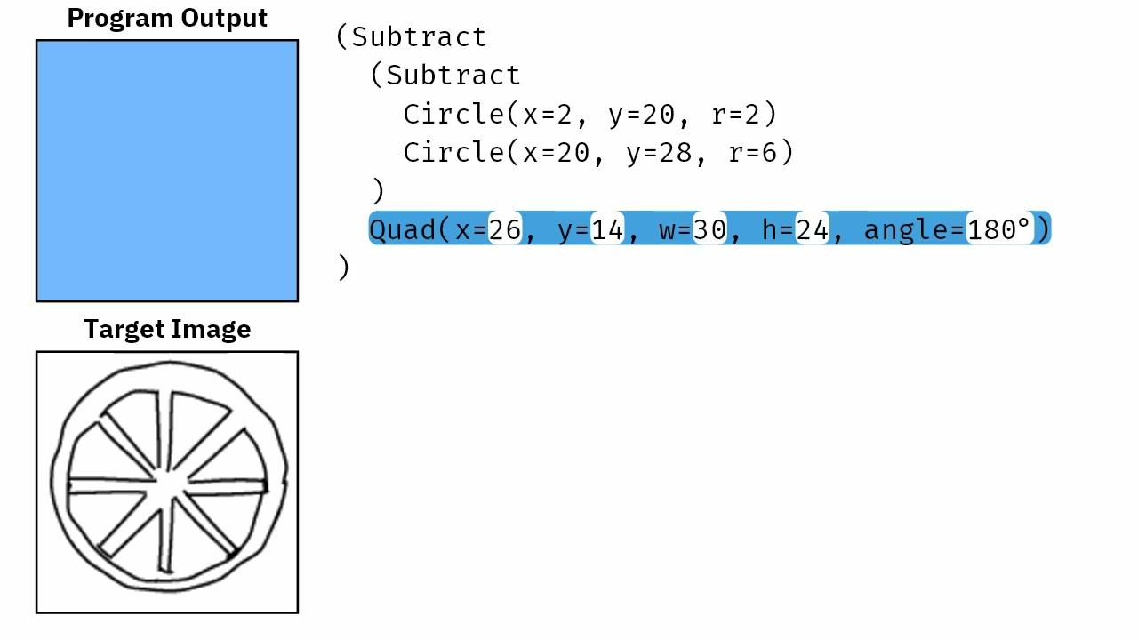
Autoregressive strategies aren’t always ideal
Reversal curse
Global-context in-filling tasks e.g. Sudoku
Coding…?
…although, a properly scaled ARM can probably do most of these things correctly – part of the pull here is doing them well with way fewer params

Slide 15
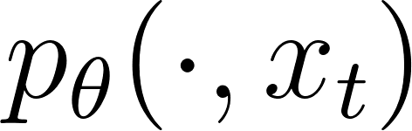
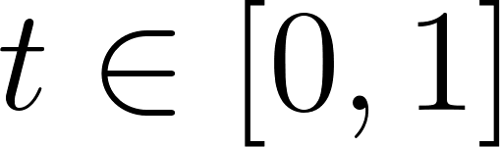
Masked Diffusion Model (MDM)
Fixed length generation, N tokens
‘Noisy samples’ are just sequences of N repeated [MASK] tokens
Sometimes ‘noisy’ is defined with N random non-[MASK] tokens, but this seems less successful a strategy
Also recent work allows us to do ‘edit’ operations to delete/insert/substitute tokens
We want to model via a mask predicting process for a partially-demasked sequence at time .
Many ways to learn/model but LLaDA still has the simplest explanation imo
(FYI: a good in-depth mathematical explanation is given in ‘Simplified and Generalized Masked Diffusion for Discrete Data’ by Shi et al. 2025)

Slide 16
Masked Diffusion Model (MDM)
Fixed length generation, N tokens
‘Noisy samples’ are just sequences of N repeated [MASK] tokens
Sometimes ‘noisy’ is defined with N random non-[MASK] tokens, but this seems less successful a strategy
Also recent work allows us to do ‘edit’ operations to delete/insert/substitute tokens
We want to model via a mask predicting process for a partially-demasked sequence at time .
Many ways to learn/model but LLaDA still has the simplest explanation imo
(FYI: a good in-depth mathematical explanation is given in ‘Simplified and Generalized Masked Diffusion for Discrete Data’ by Shi et al. 2025)

Slide 17
Masked Diffusion Model (MDM)
Fixed length generation, N tokens
‘Noisy samples’ are just sequences of N repeated [MASK] tokens
Sometimes ‘noisy’ is defined with N random non-[MASK] tokens, but this seems less successful a strategy
Also recent work allows us to do ‘edit’ operations to delete/insert/substitute tokens
We want to model via a mask predicting process for a partially-demasked sequence at time .
Many ways to learn/model but LLaDA still has the simplest explanation imo
(FYI: a good in-depth mathematical explanation is given in ‘Simplified and Generalized Masked Diffusion for Discrete Data’ by Shi et al. 2025)

Slide 18
Masked Diffusion Model (MDM)
Fixed length generation, N tokens
‘Noisy samples’ are just sequences of N repeated [MASK] tokens
Sometimes ‘noisy’ is defined with N random non-[MASK] tokens, but this seems less successful a strategy
Also recent work allows us to do ‘edit’ operations to delete/insert/substitute tokens
We want to model via a mask predicting process for a partially-demasked sequence at time .
Many ways to learn/model but LLaDA still has the simplest explanation imo
(FYI: a good in-depth mathematical explanation is given in ‘Simplified and Generalized Masked Diffusion for Discrete Data’ by Shi et al. 2025)

Slide 19
Masked Diffusion Model (MDM)
Fixed length generation, N tokens
‘Noisy samples’ are just sequences of N repeated [MASK] tokens
Sometimes ‘noisy’ is defined with N random non-[MASK] tokens, but this seems less successful a strategy
Also recent work allows us to do ‘edit’ operations to delete/insert/substitute tokens
We want to model via a mask predicting process for a partially-demasked sequence at time .
Many ways to learn/model but LLaDA still has the simplest explanation imo
(FYI: a good in-depth mathematical explanation is given in ‘Simplified and Generalized Masked Diffusion for Discrete Data’ by Shi et al. 2025)

Slide 20
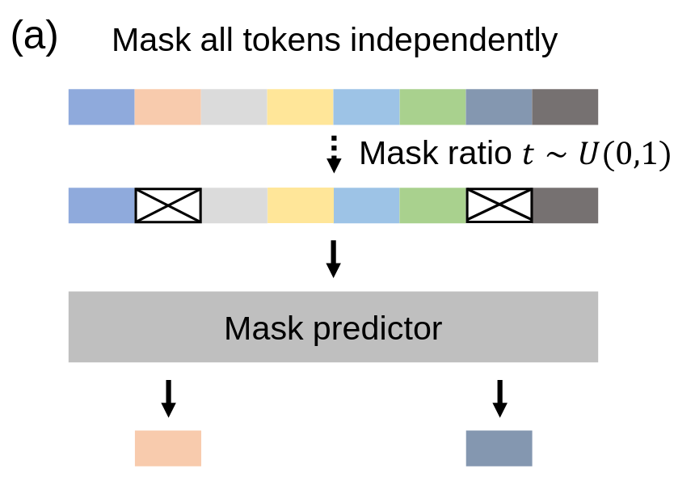
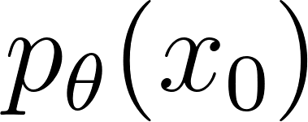
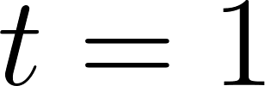
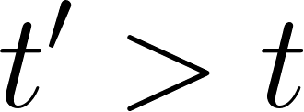
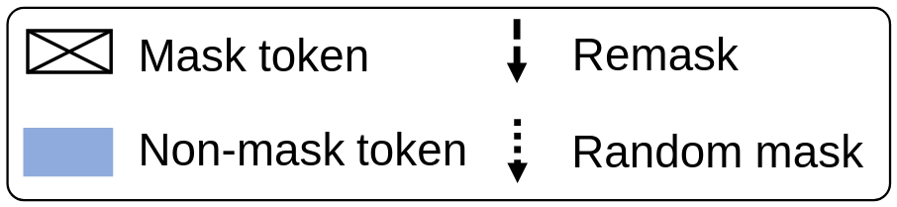
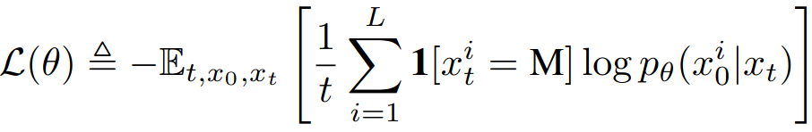
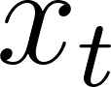
Masked Diffusion Model (MDM)
Model the data distribution with a:
forward process: gradually mask tokens (independently) until fully masked at :
At time each token is masked with prob.
(Once a token is masked it stays masked for .)
reverse process: predict masked tokens as moves from 0 to 1:
Based on a mask predictor trained with cross-entropy loss only on the masked tokens:
where , and is sampled from the forward process.

Slide 21
Masked Diffusion Model (MDM)
Model the data distribution with a:
forward process: gradually mask tokens (independently) until fully masked at :
At time each token is masked with prob.
(Once a token is masked it stays masked for .)
reverse process: predict masked tokens as moves from 0 to 1:
Based on a mask predictor trained with cross-entropy loss only on the masked tokens:
where , and is sampled from the forward process.

Slide 22
Masked Diffusion Model (MDM)
Model the data distribution with a:
forward process: gradually mask tokens (independently) until fully masked at :
At time each token is masked with prob.
(Once a token is masked it stays masked for .)
reverse process: predict masked tokens as moves from 0 to 1:
Based on a mask predictor trained with cross-entropy loss only on the masked tokens:
where , and is sampled from the forward process.

Slide 23
Masked Diffusion Model (MDM)
Model the data distribution with a:
forward process: gradually mask tokens (independently) until fully masked at :
At time each token is masked with prob.
(Once a token is masked it stays masked for .)
reverse process: predict masked tokens as moves from 0 to 1:
Based on a mask predictor trained with cross-entropy loss only on the masked tokens:
where , and is sampled from the forward process.

Slide 24
Masked Diffusion Model (MDM)
Model the data distribution with a:
forward process: gradually mask tokens (independently) until fully masked at :
At time each token is masked with prob.
(Once a token is masked it stays masked for .)
reverse process: predict masked tokens as moves from 0 to 1:
Based on a mask predictor trained with cross-entropy loss only on the masked tokens:
where , and is sampled from the forward process.

Slide 25
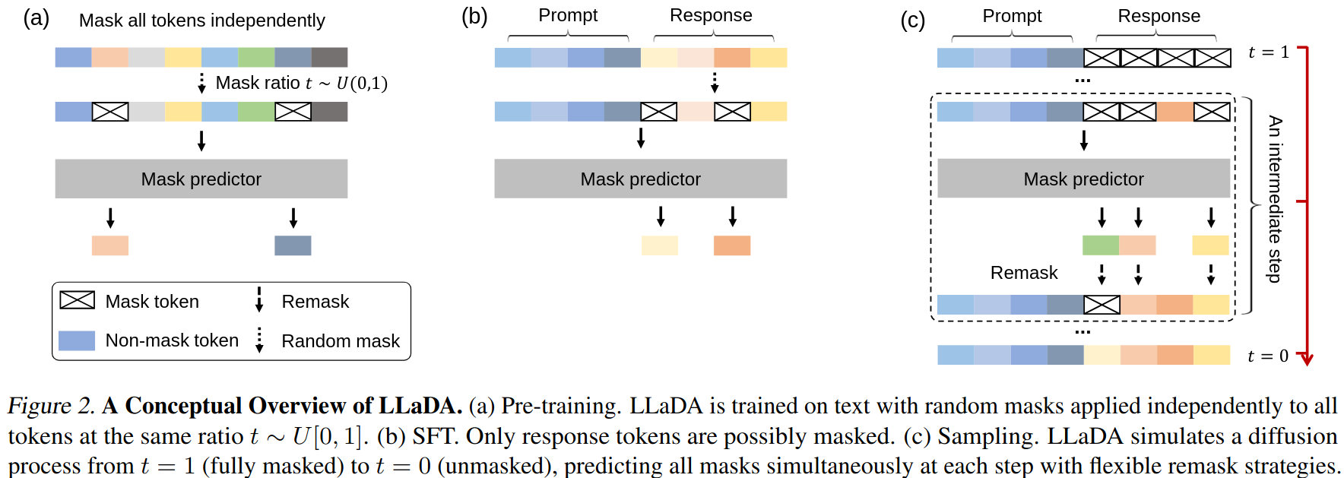
How do we apply the standard LLM pipeline?
Pretraining
SFT
Sampling

Slide 26
How do we apply the standard LLM pipeline?
Pretraining
SFT
Sampling

Slide 27
How do we apply the standard LLM pipeline?
Pretraining
SFT
Sampling

Slide 28
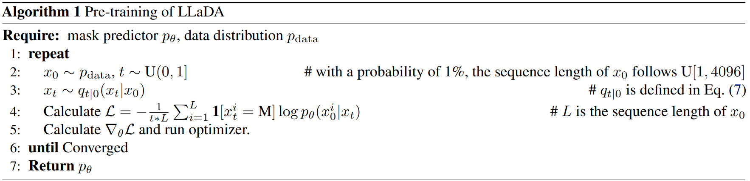
Pretraining
Train the mask predictor as we just described:

Slide 29
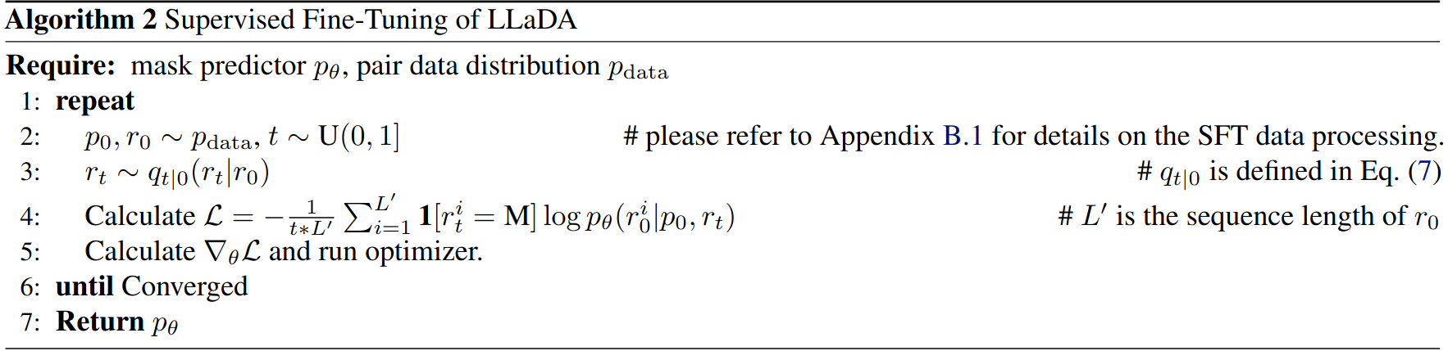
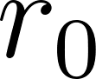
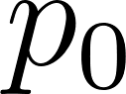
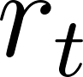
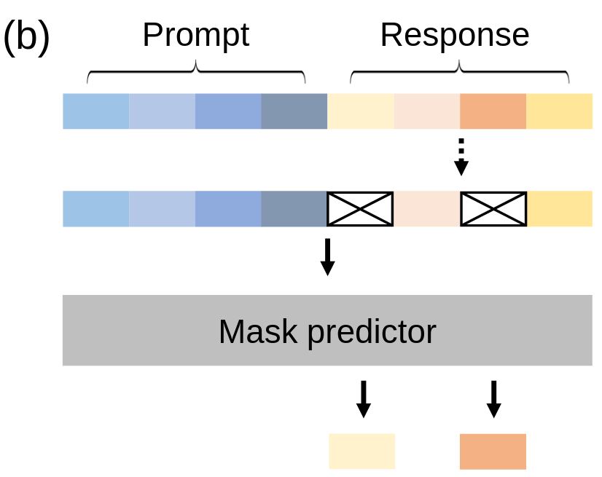
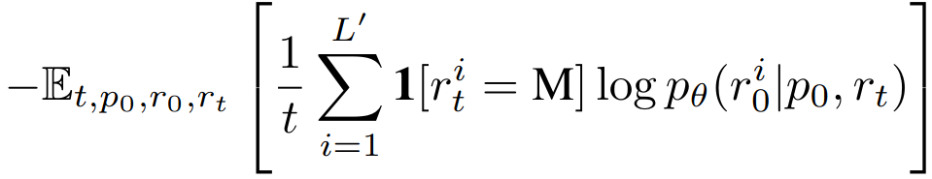
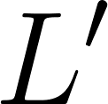
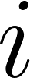
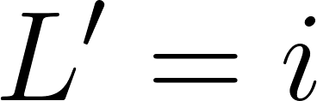
SFT
Slightly different loss (only care about response given prompt and intermediate response ):
Where is a dynamic length:
SFT training examples padded with |EOS| to get to 4096 tokens
Model is trained to generate these |EOS| tokens (they get masked in forward process)
When |EOS| sampled in reverse process for token , we set and ignore everything after (?) (slightly unclear)

Slide 30
SFT
Slightly different loss (only care about response given prompt and intermediate response ):
Where is a dynamic length:
SFT training examples padded with |EOS| to get to 4096 tokens
Model is trained to generate these |EOS| tokens (they get masked in forward process)
When |EOS| sampled in reverse process for token , we set and ignore everything after (?) (slightly unclear)

Slide 31
SFT
Slightly different loss (only care about response given prompt and intermediate response ):
Where is a dynamic length:
SFT training examples padded with |EOS| to get to 4096 tokens
Model is trained to generate these |EOS| tokens (they get masked in forward process)
When |EOS| sampled in reverse process for token , we set and ignore everything after (?) (slightly unclear)

Slide 32
SFT
Slightly different loss (only care about response given prompt and intermediate response ):
Where is a dynamic length:
SFT training examples padded with |EOS| to get to 4096 tokens
Model is trained to generate these |EOS| tokens (they get masked in forward process)
When |EOS| sampled in reverse process for token , we set and ignore everything after (?) (slightly unclear)

Slide 33
SFT
Slightly different loss (only care about response given prompt and intermediate response ):
Where is a dynamic length:
SFT training examples padded with |EOS| to get to 4096 tokens
Model is trained to generate these |EOS| tokens (they get masked in forward process)
When |EOS| sampled in reverse process for token , we set and ignore everything after (?) (slightly unclear)

Slide 34
SFT
Slightly different loss (only care about response given prompt and intermediate response ):
Where is a dynamic length:
SFT training examples padded with |EOS| to get to 4096 tokens
Model is trained to generate these |EOS| tokens (they get masked in forward process)
When |EOS| sampled in reverse process for token , we delete it and decrease by 1.

Slide 35
SFT
Slightly different loss (only care about response given prompt and intermediate response ):
Where is a dynamic length:
SFT training examples padded with |EOS| to get to 4096 tokens
Model is trained to generate these |EOS| tokens (they get masked in forward process)
When |EOS| sampled in reverse process for token , we delete it and decrease by 1.

Slide 36
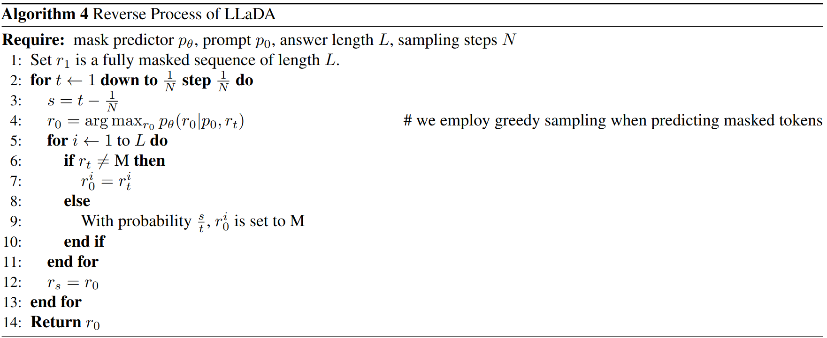

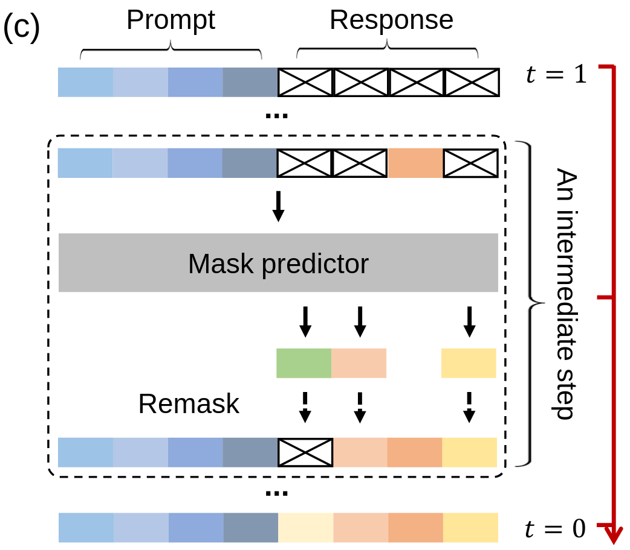
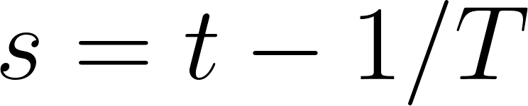
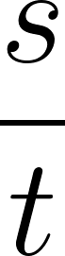
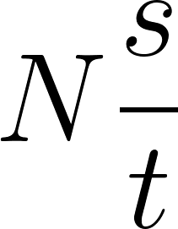
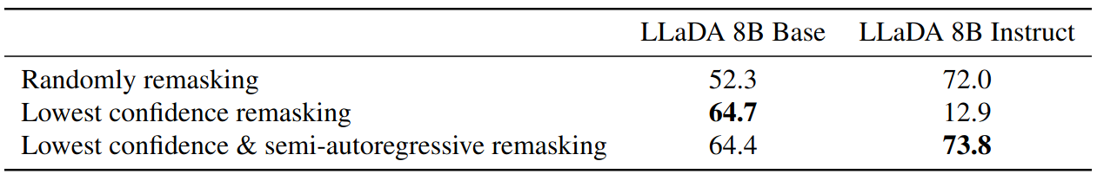
Sampling
Choose sampling steps (tradeoff between efficiency and sample quality) between 1 and 0.
For each , predict then (“at time “), remask the tokens with probability .
Either remask each token independently
Or remask the tokens with lowest logits.
(on GSM8K)

Slide 37
Sampling
Choose sampling steps (tradeoff between efficiency and sample quality) between 1 and 0.
For each , predict then (“at time “), remask the tokens with probability .
Either remask each token independently
Or remask the tokens with lowest logits.
(on GSM8K)

Slide 38
Sampling
Choose sampling steps (tradeoff between efficiency and sample quality) between 1 and 0.
For each , predict then (“at time “), remask the tokens with probability .
Either remask each token independently
Or remask the tokens with lowest logits.
(on GSM8K)

Slide 39
Sampling
Choose sampling steps (tradeoff between efficiency and sample quality) between 1 and 0.
For each , predict then (“at time “), remask the tokens with probability .
Either remask each token independently
Or remask the tokens with lowest logits.
(on GSM8K)

Slide 40
Sampling
Choose sampling steps (tradeoff between efficiency and sample quality) between 1 and 0.
For each , predict then (“at time “), remask the tokens with probability .
Either remask each token independently
Or remask the tokens with lowest logits.
(on GSM8K)

Slide 41
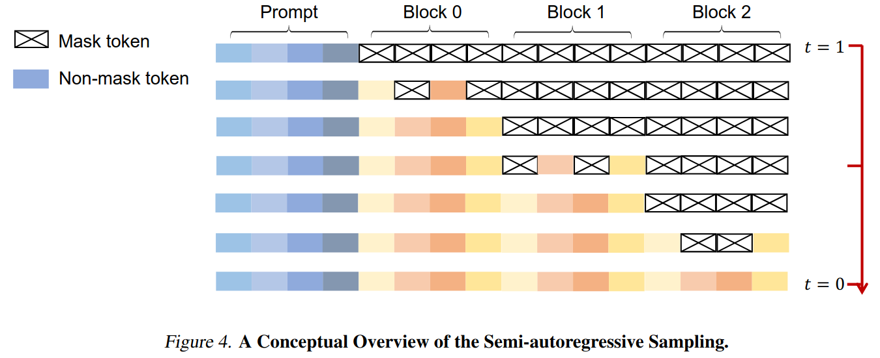
Semi-autoregressive Sampling
Additionally, we can split the response up into several blocks and generate those from left to right.

Slide 42
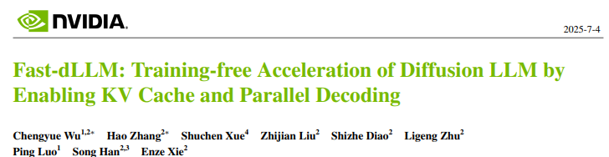
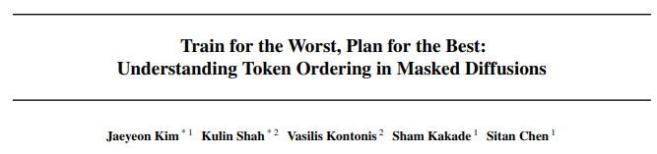
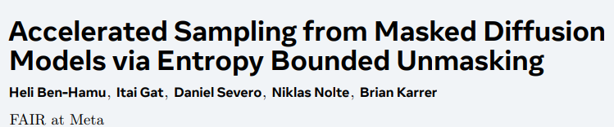
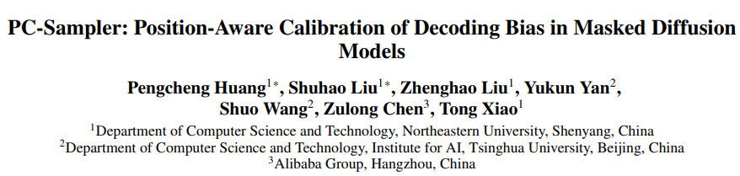



But the space of possible sampling strategies is HUGE

Slide 43





Strategy 0: IID per token (e.g. MD4)
Go from all-noise at to noiseless at .
At time we will unmask token at index with probability .
For this token, we sample the new non-[MASK] token value using mask-prediction probabilities .
Many options are available for the schedule .

Slide 44
Strategy 0: IID per token (e.g. MD4)
Go from all-noise at to noiseless at .
At time we will unmask token at index with probability .
For this token, we sample the new non-[MASK] token value using mask-prediction probabilities .
Many options are available for the schedule .

Slide 45

Strategy 0: IID per token (e.g. MD4)
Go from all-noise at to noiseless at .
At time we will unmask token at index with probability .
For this token, we sample the new non-[MASK] token value using mask-prediction probabilities .
Many options are available for the schedule .

Slide 46
Strategy 0: IID per token (e.g. MD4)
Go from all-noise at to noiseless at .
At time we will unmask token at index with probability .
For this token, we sample the new non-[MASK] token value using mask-prediction probabilities .
Many options are available for the schedule .

Slide 47

Strategy 0: IID per token (e.g. MD4)
Go from all-noise at to noiseless at .
At time we will unmask token at index with probability .
For this token, we sample the new non-[MASK] token value using mask-prediction probabilities .
Many options are available for the schedule .

Slide 48







Strategy 1: Greedy/Top probability sampling
To unmask tokens in a step from time to time (often ) :
Assign a confidence to each index given by greatest token-probability:
Order by confidence: greatest confidence
Select the top indices to decode/sample in decreasing order of .

Slide 49
Strategy 1: Greedy/Top probability sampling
To unmask tokens in a step from time to time (often ) :
Assign a confidence to each index given by greatest token-probability:
Order by confidence: greatest confidence
Select the top indices to decode/sample in decreasing order of .

Slide 50
Strategy 1: Greedy/Top probability sampling
To unmask tokens in a step from time to time (often ) :
Assign a confidence to each index given by greatest token-probability:
Order by confidence: greatest confidence
Select the top indices to decode/sample in decreasing order of .

Slide 51
Strategy 1: Greedy/Top probability sampling
To unmask tokens in a step from time to time (often ) :
Assign a confidence to each index given by greatest token-probability:
Order by confidence: greatest confidence
Select the top indices to decode/sample in decreasing order of .

Slide 52






Strategy 2: Top Probability Margin
Similar to Top Probability (Strategy 1), except use probability margin for confidence score:
Where
I.e. the difference between the two highest probabilities for a given token index.
Select top of indices according to
Helps to avoid prematurely unmasking at an index where two token values both have high probability.

Slide 53
Strategy 2: Top Probability Margin
Similar to Top Probability (Strategy 1), except use probability margin for confidence score:
Where
I.e. the difference between the two highest probabilities for a given token index.
Select top of indices according to
Helps to avoid prematurely unmasking at an index where two token values both have high probability.

Slide 54
Strategy 2: Top Probability Margin
Similar to Top Probability (Strategy 1), except use probability margin for confidence score:
Where
I.e. the difference between the two highest probabilities for a given token index.
Select top of indices according to
Helps to avoid prematurely unmasking at an index where two token values both have high probability.

Slide 55
Strategy 2: Top Probability Margin
Similar to Top Probability (Strategy 1), except use probability margin for confidence score:
Where
I.e. the difference between the two highest probabilities for a given token index.
Select top of indices according to
Helps to avoid prematurely unmasking at an index where two token values both have high probability.

Slide 56






Strategy 3: Confidence-Aware Parallel Decoding
Unmask tokens that have a highest-token probability above a global threshold.
Like top probability, let and
let be the -th largest value of .
Unmask all tokens where
for some global threshold
(they test ).

Slide 57
Strategy 3: Confidence-Aware Parallel Decoding
Unmask tokens that have a highest-token probability above a global threshold.
Like top probability, let and
let be the -th largest value of .
Unmask all tokens where
for some global threshold
(they test ).

Slide 58
Strategy 3: Confidence-Aware Parallel Decoding
Unmask tokens that have a highest-token probability above a global threshold.
Like top probability, let and
let be the -th largest value of .
Unmask all tokens where
for some global threshold
(they test ).
(red numbers are # tokens decoded per step)

Slide 59










Strategy 4: PC Samplers (Position-Aware Calibration)
Weight the confidence score as , for timestep and (currently masked) index .
Write and for and where is the prob. of seeing token in some large corpus
Note that large encourages autoregressive-like decoding
Small encourages more flexible orderings for decoding
They hand-select one of depending on the task
imo this is a wasted opportunity to learn the values in a more interesting way...

Slide 60
Strategy 4: PC Samplers (Position-Aware Calibration)
Weight the confidence score as , for timestep and (currently masked) index .
Write and for and where is the prob. of seeing token in some large corpus
Note that large encourages autoregressive-like decoding
Small encourages more flexible orderings for decoding
They hand-select one of depending on the task
imo this is a wasted opportunity to learn the values in a more interesting way...

Slide 61
Strategy 4: PC Samplers (Position-Aware Calibration)
Weight the confidence score as , for timestep and (currently masked) index .
Write and for and where is the prob. of seeing token in some large corpus
Note that large encourages autoregressive-like decoding
Small encourages more flexible orderings for decoding
They hand-select one of depending on the task
imo this is a wasted opportunity to learn the values in a more interesting way...

Slide 62

Strategy 4: PC Samplers (Position-Aware Calibration)
Weight the confidence score as , for timestep and (currently masked) index .
Write and for and where is the prob. of seeing token in some large corpus
Note that large encourages autoregressive-like decoding
Small encourages more flexible orderings for decoding
They hand-select some depending on the task
imo this is a wasted opportunity to learn the values in a more interesting way...

Slide 63
Strategy 4: PC Samplers (Position-Aware Calibration)
Weight the confidence score as , for timestep and (currently masked) index .
Write and for and where is the prob. of seeing token in some large corpus
Note that large encourages autoregressive-like decoding
Small encourages more flexible orderings for decoding
They hand-select some depending on the task
imo this is a wasted opportunity to learn the values in a more interesting way...

Slide 64



Strategy 4.1: GenMD4
For each token position , use a denoising schedule/probability where we learn per index via gradient descent.
Difficult to optimise
Use reinforce leave-one-out
“Easily overfits”
Doesn’t seem like a feasible solution long-term

Slide 65
Strategy 4.1: GenMD4
For each token position , use a denoising schedule/probability where we learn per index via gradient descent.
Difficult to optimise
Use reinforce leave-one-out
“Easily overfits”
Doesn’t seem like a feasible solution long-term

Slide 66
Strategy 4.1: GenMD4
For each token position , use a denoising schedule/probability where we learn per index via gradient descent.
Difficult to optimise
Use reinforce leave-one-out
“Easily overfits”
Doesn’t seem like a feasible solution long-term

Slide 67
Strategy 4.1: GenMD4
For each token position , use a denoising schedule/probability where we learn per index via gradient descent.
Difficult to optimise
Use reinforce leave-one-out
“Easily overfits”
Doesn’t seem like a feasible solution long-term

Slide 68



Strategy 4.2: Hyperschedules
Unifying autoregression and diffusion: basically just set (by hand) some patterns for depending on the token index to encourage decoding to behave more or less autoregressively (depending on the task).

Slide 69
Strategy 4.2: Hyperschedules
Unifying autoregression and diffusion: basically just set (by hand) some patterns for depending on the token index to encourage decoding to behave more or less autoregressively (depending on the task).

Slide 70
Strategy 4.2: Hyperschedules
Unifying autoregression and diffusion: basically just set (by hand) some patterns for depending on the token index to encourage decoding to behave more or less autoregressively (depending on the task).

Slide 71








Strategy 5: Entropy Bound Samplers
Unmask the largest subset of token indices such that
for some .
will unmask one token at a time (with the lowest entropy prediction distribution)
will unmask all tokens in one go
They experiment with .

Slide 72
Strategy 5: Entropy Bound Samplers
Unmask the largest subset of token indices such that
for some .
will unmask one token at a time (with the lowest entropy prediction distribution)
will unmask all tokens in one go
They experiment with .

Slide 73
Strategy 5: Entropy Bound Samplers
Unmask the largest subset of token indices such that
for some .
will unmask one token at a time (with the lowest entropy prediction distribution)
will unmask all tokens in one go
They experiment with .

Slide 74
Strategy 5: Entropy Bound Samplers
Unmask the largest subset of token indices such that
for some .
will unmask one token at a time (with the lowest entropy prediction distribution)
will unmask all tokens in one go
They experiment with .

Slide 75






Strategy 6: Learning an auxiliary index-selection model
As in the previous strategy, consider the problem as finding a subset of token indices for each denoising step (in discrete time) s.t. and for all (i.e. form a partition of ).
Let’s treat as a random variable with approximate posterior and generative distribution , then optimise with VI.
Hopefully this will give us:
Sensible simultaneous decoding (of tokens which don’t contradict each other)
Maybe better overall performance
Decoding in many fewer steps, T, than other methods
Hopefully a better performance-speed trade-off

Slide 76
Strategy 6: Learning an auxiliary index-selection model
As in the previous strategy, consider the problem as finding a subset of token indices for each denoising step (in discrete time) s.t. and for all (i.e. form a partition of ).
Let’s treat as a random variable with approximate posterior and generative distribution , then optimise with VI.
Hopefully this will give us:
Sensible simultaneous decoding (of tokens which don’t contradict each other)
Maybe better overall performance
Decoding in many fewer steps, T, than other methods
Hopefully a better performance-speed trade-off

Slide 77
Strategy 6: Learning an auxiliary index-selection model
As in the previous strategy, consider the problem as finding a subset of token indices for each denoising step (in discrete time) s.t. and for all (i.e. form a partition of ).
Let’s treat as a random variable with approximate posterior and generative distribution , then optimise with VI.
Hopefully this will give us:
Sensible simultaneous decoding (of tokens which don’t contradict each other)
Maybe better overall performance
Decoding in many fewer steps, T, than other methods
Hopefully a better performance-speed trade-off

Slide 78
Strategy 6: Learning an auxiliary index-selection model
As in the previous strategy, consider the problem as finding a subset of token indices for each denoising step (in discrete time) s.t. and for all (i.e. form a partition of ).
Let’s treat as a random variable with approximate posterior and generative distribution , then optimise with VI.
Hopefully this will give us:
Sensible simultaneous decoding (of tokens which don’t contradict each other)
Maybe better overall performance
Decoding in many fewer steps, T, than other methods
Hopefully a better performance-speed trade-off

Slide 79
Strategy 6: Learning an auxiliary index-selection model
As in the previous strategy, consider the problem as finding a subset of token indices for each denoising step (in discrete time) s.t. and for all (i.e. form a partition of ).
Let’s treat as a random variable with approximate posterior and generative distribution , then optimise with VI.
Hopefully this will give us:
Sensible simultaneous decoding (of tokens which don’t contradict each other)
Maybe better overall performance
Decoding in many fewer steps, T, than other methods
Hopefully a better performance-speed trade-off

Slide 80

Final thoughts
I may have been too pessimistic about the future of discrete diffusion LLMs in my earlier presentation
I’m still not certain if they’ll ‘beat’ ARMs
But I do still think they’re fun

Slide 81
Final thoughts
I may have been too pessimistic about the future of discrete diffusion LLMs in my earlier presentation
I’m still not certain if they’ll ‘beat’ ARMs (but it’s not impossible)
But I do still think they’re fun

Slide 82
Final thoughts
I may have been too pessimistic about the future of discrete diffusion LLMs in my earlier presentation
I’m still not certain if they’ll ‘beat’ ARMs (but it’s not impossible)
But I do still think they’re fun

Slide 83

Bonus: Blockwise KV-Caching

Slide 85


Strategy 2: Greedy + Gumbel Noise
Like previous but adds noise (from a truncated Gumbel distribution) to the categorical probabilities to improve numerical stability.
Authors noticed that MDMs get very low generative perplexity (as scored by some other LM, e.g. GPT2…), but often with crappy generations if float precision isn’t high enough

